Slide 1
2024 Social Media Overview
Wendy Felton
Executive Director, Social Media

Slide 2
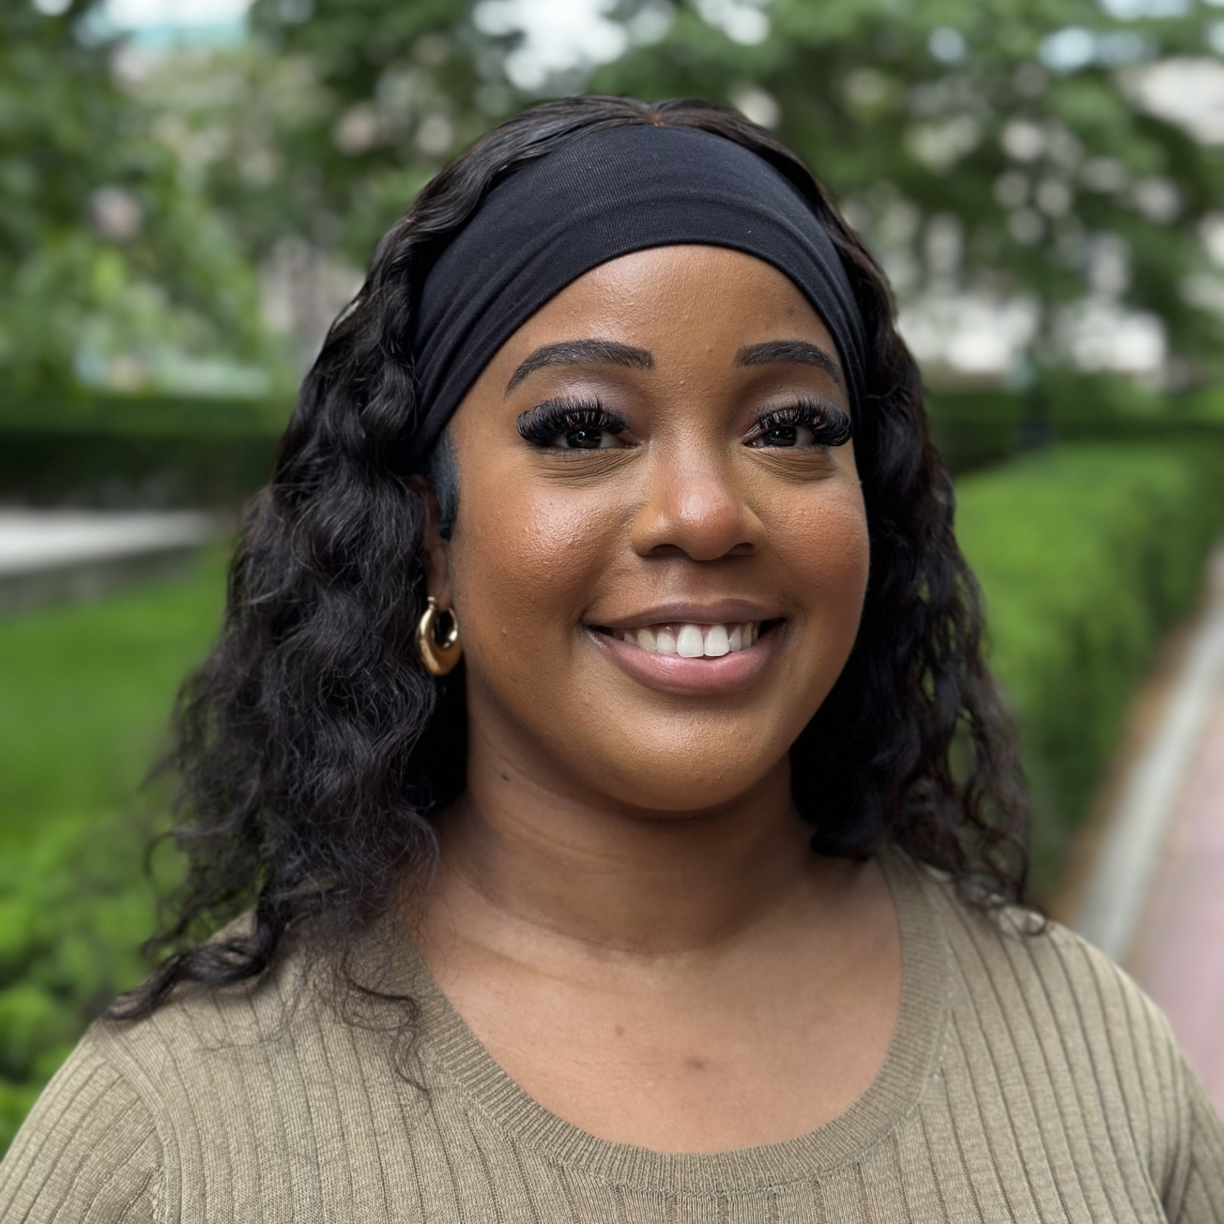
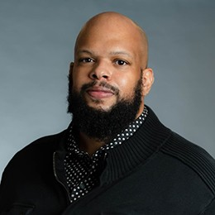
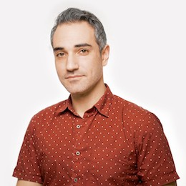
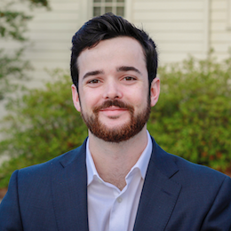
Meet the team
Wendy Felton
Executive Director, Social Media
Michael Orrange
Associate Director, Communications
Jennifer Pellerito
Associate Director,
Photos and Digital Communications
Kymani Hayden
Assistant Director of Social Media and Digital Outreach
Robert Branch
Director, Digital Productions
Spencer Snyder
Videographer
Dustin Foote
Video Producer

Slide 3
Where we are now
Where we’re headed
How we’ll stay connected

Slide 4
2023 Recap
Audience
Total followers: just over 2 million in early 2024
Added 314K followers in 2023
Who we’re reaching effectively:
Men 25-34, based in New York and the United States
Our largest female-identifying audience is on Instagram
Significant audience bases in India, Indonesia, China, Brazil

Slide 5
2023 Recap
Impressions
Engagements
Content
6.58 million impressions
277K engagements, for a 4.2% engagement rate
Most engaging content:
Commencement
Campus beauty
Unique campus happenings (photo of hazy skies from June)
Good news (admissions decisions, President Shafik’s appointment)

Slide 6
Platforms and Performance
Doing well
LinkedIn
Instagram
Deprecating
X/Twitter
Turning to...
TikTok
Threads

Slide 7
Refreshing our strategy
“What’s it like at Columbia University?”
Focusing on experiential content
Connecting to current and prospective students by reflecting their lived experiences
Celebrating Columbia’s diversity through content about religious and cultural observations
Highlighting President Shafik’s strategic priorities
Standardizing our approach to ongoing content
Templatized promotion for events, research, and thought leadership
Building engagement through original content

Slide 8
New Resources
External guidelines
Public-facing document
A user’s guide for anyone who interacts with us on social media
Includes information on Columbia policies that pertain to social media activity
Comment moderation policy
Guidance for managing comments and replies
Provides an overview of Columbia’s stance on comments and specific guidance for moderation
Platform reference guide
Clarity about Columbia social accounts
Internal best practices
Columbia-only document
Ensure the security, integrity, and continuity of social media accounts
Build brand consistency across the University
Boost social media performance
Editorial calendar
Dates to mark on social media including hashtag holidays, religious and cultural celebrations, and world events

Slide 9
Staying Connected and Collaborating
Social media Slack
Weekly drop-in office hours in Low Library
Quarterly meetings

Slide 10
Thank you!

